Slide 1
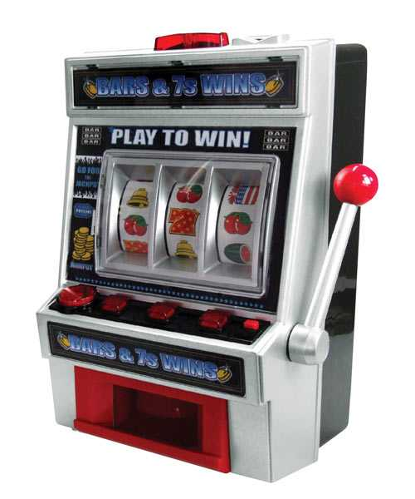
Slot machines
A healthy way to learn about connectives!

Slide 3
Definitions
C = You got all the same color
S = You got all the same shape
C ∨ S = You got all the same color OR shape
W = You win
Rule of the game: W if and only if C ∨ S

Slide 4
C = False; S = False; C ∨ S = False

Slide 5
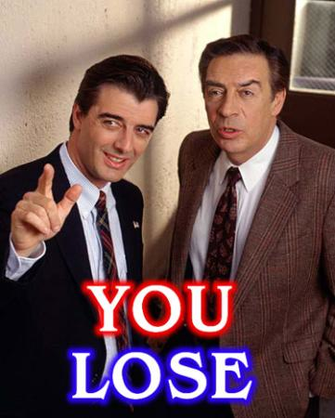

Slide 7
C = False; S = True; C ∨ S = True

Slide 8

W = True!!!

Slide 10
C = False; S = False; C ∨ S = False

Slide 11

Sorry! W = False.

Slide 13
C = True; S = True; C ∨ S = True

Slide 14

W = True!!!

Slide 16
C = True; S = False; C ∨ S = True

Slide 17

W = True!!!

Slide 18
C | S | C ∨ S | W
T | T | T | T
T | F | T | T
F | T | T | T
F | F | F | F

Slide 19
New Rules!
C ∧ S = You got all the same color AND shape
Rule of the game: W if and only if C ∧ S

Slide 20
C | S | C ∧ S | W
T | T | T | T
T | F | F | F
F | T | F | F
F | F | F | F

