Slide 1
A Tiny Corpus Investigation of Deictic Day Names
Elizabeth Coppock
September 24, 2010

Slide 2
Fillmore’s prediction
From Charles Fillmore (1971/1997), Deixis I (p. 72):
[A]ssuming that I know today is Wednesday, I would not say “I am planning to have dinner in Santa Cruz this Wednesday”. The reason seems to be that the deictic day words, namely “today”, “tomorrow”, “yesterday”, seem to have priority over these other expressions when you are locating the time of some event…

Slide 3
Fillmore’s prediction, continued
… [T]here is one set of conventions followed by many speakers of English by which the dating expressions of the form “this” followed by a weekday name are used only of times which follow, within the same week, the coding time…

Slide 4
Fillmore’s prediction, continued
… For speakers of this dialect, because of the priority of deictic day names, there is never any need for the expression “this Monday”…

Slide 5
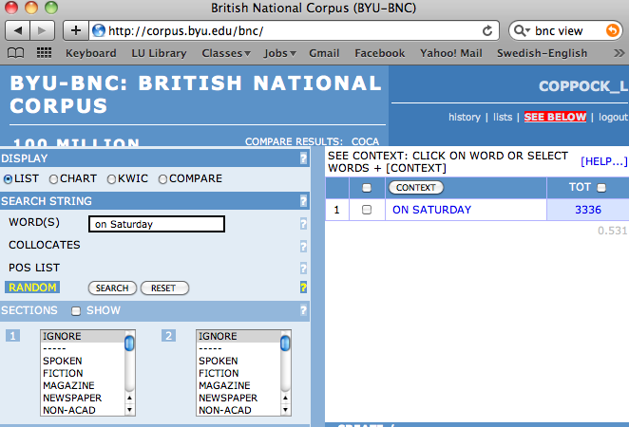
BNC Corpus: corpus.byu.edu/bnc/

Slide 6
Frequency of “this DAYNAME”

Slide 7
Base Frequency of Day Names

Slide 8
Frequency of “this DAYNAME”/
Base Frequency of “DAYNAME”

Slide 9
Frequency of “last DAYNAME”/
Frequency of “DAYNAME”

Slide 10
Frequency of “on DAYNAME”/
Frequency of “DAYNAME”

