Slide 1
Exclusive Updates!
Elizabeth Coppock, Heinrich Heine University, Düsseldorf
David Beaver, University of Texas at Austin
Amsterdam Colloquium 2011

Slide 2
Overview
We present a dynamic semantics in which contexts contain not only information, but also questions.
The questions can be local to the restrictor of a quantifier, and the quantifier can bind into the questions.
With this framework, we give an analysis of exclusives like only and mere, and show how they constrain and depend on a local question.

Slide 3
Some equivalences
He is only a janitor ⇔He is just a janitor ⇔ He is a mere janitor
Only he is a janitor ⇔ He is the only janitor

Slide 4
Beaver and Clark (2008) on only
Presupposition: At least P
Assertion: At most P
where “at least” and “at most” rely on the current Question Under Discussion (CQ)
only_{S} = λp . λw : min_{S}(p)(w) . max_{S}(p)(w)
min_{S}(p) = λw . ∀p' ∈ cq_{S} [p'(w) → p' ≥ p ]
max_{S}(p) = λw . ∀p' ∈ cq_{S} [p'(w) → p ≥ p' ]

Slide 5
Scalar readings
He is only a janitor / He is just a janitor / He is a mere janitor
manager
secretary
janitor
homeless guy who’s always around

Slide 6
Scalar readings
He is only a janitor / He is just a janitor / He is a mere janitor
manager
Presupposed:
He’s at least a janitor
secretary
janitor
homeless guy who’s always around

Slide 7
Scalar readings
He is only a janitor / He is just a janitor / He is a mere janitor
manager
At-issue:
He’s at most a janitor
secretary
janitor
homeless guy who’s always around

Slide 8
Scalar readings
He is not just a janitor ⇔ He is not a mere janitor
manager
At-issue:
He’s not at most a janitor
secretary
janitor
homeless guy who’s always around

Slide 9
Quantificational readings
  John invited only Mary & Sue / Only Mary & Sue were invited by John
Mary & Sue & Bill & Fred
Sue & Bill & Fred
Mary & Sue & Bill
Mary & Bill & Fred
Mary & Sue & Fred
Bill & Fred
Mary & Bill
Mary & Sue
Sue & Fred
Sue & Bill
Mary & Fred
Bill
Mary
Sue
Fred

Slide 10
Quantificational readings
  John invited only Mary & Sue / Only Mary & Sue were invited by John
Mary & Sue & Bill & Fred
Sue & Bill & Fred
Mary & Sue & Bill
Mary & Bill & Fred
Mary & Sue & Fred
Bill & Fred
Mary & Bill
Mary & Sue
Sue & Fred
Sue & Bill
Mary & Fred
Bill
Mary
Sue
Fred
Presupposed: At least Mary and Sue

Slide 11
Quantificational readings
  John invited only Mary & Sue / Only Mary & Sue were invited by John
Mary & Sue & Bill & Fred
Sue & Bill & Fred
Mary & Sue & Bill
Mary & Bill & Fred
Mary & Sue & Fred
Bill & Fred
Mary & Bill
Mary & Sue
Sue & Fred
Sue & Bill
Mary & Fred
Bill
Mary
Sue
Fred
Asserted: At most Mary and Sue

Slide 12
Quantificational readings
  John did not only invite Mary & Sue
Mary & Sue & Bill & Fred
Sue & Bill & Fred
Mary & Sue & Bill
Mary & Bill & Fred
Mary & Sue & Fred
Bill & Fred
Mary & Bill
Mary & Sue
Sue & Fred
Sue & Bill
Mary & Fred
Bill
Mary
Sue
Fred
At-issue: Not at most Mary and Sue

Slide 13
Parameters of variation
Coppock and Beaver (2011) propose that all exclusives presuppose ‘at least P’ and assert ‘at most P’ and vary along two dimensions:
  Semantic type
  Constraints on the CQ and the ranking over its answers
Adjectival exclusives (mere, adjectival only) typically instantiate a type-lifted version of Beaver and Clark’s only:
g-only_{S} = λp_{<e,p>} . λ x_{e} . only_{S}(p(x))

Slide 14
Evidence for locality
Adjectival exclusives license NPIs in their semantic scope:
(1) The only student who asked any questions got an A.
(2) *A mere student who asked any questions got an A.
(2’) A mere 4% of students there ever graduate.
but not outside of it:
(3) *A mere student said anything.
(4) *The only student said anything.

Slide 15
General schema for exclusives
Adjectives: g-only_{S} = λp_{<e,p>} . λ x_{e} . only_{S}(p(x))
VP-only can be analyzed as an <ep,ep> modifier too.
NP-only and quantifier-modifying mere can be analyzed as <<ep,p>,<ep,p>> modifiers, like so:
gg-only_{S} = λq_{<ep,p>} . λ p_{ep} . only_{S}(q(p))
So in general, exclusives look like:
λp_{<σ,p>} . λ x_{<σ,p>} . only_{S}(p(x))

Slide 16
Constraints on the QUD
For mere the question is, “what properties does x have?”
For adjectival only the question is “what things are P?”
(1) A mere student proved Goldbach’s conjecture.
(2) The only student proved Goldbach’s conjecture.

Slide 17
Discourse presuppositions
Constraints on the QUD are not like the presuppositions of factive verbs or definite descriptions.
They constrain the discourse context, rather than the set of commonly shared assumptions or beliefs.
A term for this type: discourse presupposition.
How to express such presuppositions?
  Need independently recognized by Jäger (1996) and Aloni et al. (2007) based on the apparent presupposition of a QUD by focus, and effects of questions on only’s quantificational domain.

Slide 18
Open discourse presuppositions
Because adjectival exclusives have merely local scope, these presuppositions generally contain variables that are bound by external quantifiers:
No mere child could keep the Dark Lord from returning.
This occurs with VP-only as well:
As a bilingual person I’m always running around helping everybody who only speaks Spanish.

Slide 19
Needed:
The possibility of presupposing a question
The expressibility of presuppositional constraints regarding the strength ranking over the answers to the question under discussion
Quantificational binding into presupposed questions
Compositional derivation of logical forms for sentences

Slide 20
Framework

Slide 21
Dynamic semantics with questions
Dynamic semantics based on Beaver (2001), which deals successfully with quantified presuppositions
New: A context S contains three components:
  an information state info(S)
    set of world-assignment pairs
  a current question under discussion cq(S)
    set of information states
  a strength ranking over the answers to the question ≥(S)
    binary relation over information states

Slide 22
Deriving the CQ from the ranking
cq(S) = field(≥(S))
where field(R) = { x | ∃y [ yRx ∨ xRy ] } (cf. Krifka 1999)
Ranking
CQ
<I,I>
<I,J>
<J,J>
<J,K>
<I,K>
<K,K>
I
J
K

Slide 23
Deriving info(S) from cq(S)
info(S) = ∪ cq(S) = ∪ field(≥(S)) (cf. Jäger 1996)
Ranking
CQ
Information state
<I,I>
<I,J>
<J,J>
<I,K>
<J,K>
<K,K>
I:{<g,w₁>,<g,w₂>}
J:{<g,w₁>}
K:{<g,w₂>}
<g,w₁>
<g,w₂>

Slide 24
Theory of Exclusives

Slide 25
Beaver and Clark’s only
only = λ C . { <S,S'> | S[min(C)]S ∧ S[max(C)]S' }
max =
λ C . { <S,S'> | S' ⊆ S ∧ ∀J ∈ cq(S') [ J ≥(S) info(↓C) ]}
min =
λ C . { <S,S'> | S' ⊆ S ∧ ∀J ∈ cq(S') [ info(↓C) ≥(S) J ]}
Dynamic-to-static operator:
↓C = { <I,J> | {<I,J>}C{<I,J>} }

Slide 26
Type-raised dynamic only
only = λ C . { <S,S'> | S[min(C)]S ∧ S[max(C)]S' }
g-only = λ P . λ D . { <S,S'> | S' ⊆ S ∧ S[only(P(D))]S' }

Slide 27
Analysis of mere
mere =
λ P . λ D . { <S,S'> | S[only(P(D))]S' ∧ cq(S) ⊆ ?P'[P'(D)] }
If υ is a variable of type α and φ is a CCP:
? υφ = { I | ∃x ∈ D_{α} [ I = info(↓φ[υ→x]) ] }
So:
?P'[P'(D)] = {I | ∃P ∈ D_{<d,Π>} [I = info(↓P(D)) ] }
where d is the type of discourse referents and Π is the type of CCPs (relations between contexts and contexts)

Slide 28
Predicative Example

Slide 29
A perfectly natural discourse
(1) Somebody₇ has proven Goldbach’s conjecture.
(2) He₇ is a mere child. / He₇ is only a child.
LF for (2):
mere(child)(7)

Slide 30
Analysis of child
child =
λ D . { <S,S'> | D ∈ t-domain(info(S)) ∧ info(S') =
{<w,f> ∈ info(S) | ∀ x [<D,x> ∈ f → child'(x)(w)] } }
t-domain(info(S)) means that every assignment in info(S)maps 7 to something.

Slide 31
mere(child)(7)
={ <S,S'> | S[only(child(7))]S' ∧ cq(S) ⊆ ?P'[P'(7)] }
={ <S,S'> | S[min(child(7))]S ∧ S[max(child(7))]S' ∧ cq(S) ⊆ ?P'[P'(7)] }
The <S,S'> such that S[min(child(7))]S' are those such that:
S' ⊆ S ∧ ∀J ∈ cq(S) [info(↓child(7)) ≤(S') J ]
info(↓child(7)) =
{<w,f> | ∃x [ <7,x> ∈ f ] ∧
∀ x [<7,x> ∈ f → child'(x)(w) ] }

Slide 32







Notes:
The universe of individuals

Slide 33

Notes:
Here is a set of worlds. The stars represent a predicate, say, “won”, or “proved Goldbach’s conjecture”.

Slide 34
Notes:
These are the worlds excluding those in which a baby or a dog satisfies the predicate. If someone says “somebody_7 proved Goldbach’s conjecture”, and the stars represent having proved Goldbach’s conjecture, then the conversational participants might assume that these are the only worlds left under consideration. The assignments would all map 7 to an individual that is starred in the world they are paired with (or sum of individuals that is starred). Excluding assignments of sums, this makes for 12 world-assignment pairs. This would be an appropriate information state in which to utter “He/She_7 was only a child”, assuming that the question is “What properties does 7 have?”.

Slide 35
7
7
7
7
7
7
7
7
7
7
7
Notes:
Here are the world-assignment pairs left after updating with “Somebody proved Goldbach’s conjecture”. The world-assignment pairs involving the same world are put together in the same circle.

Slide 36
7
7
7
7
7
7
7
7
7
7
7
7
Notes:
The world-assignment pairs in which 7 is mapped to a child who succeeded are circled in red. The set of those world-assignment pairs is the information state corresponding to the proposition that 7 is a child. That is one of the answers to the question, “how powerful of a being is 7?”. The remainder are pairs in which 7 is mapped to an adult. That is another answer to the question. The answer “7 is a child” is ranked lower than the answer “7 is an adult”.

Slide 37
7
7
7
7
7
7
7
7
7
7
7
7
Notes:
Here is a nicer picture showing that. The information state consisting of the world-assignment pairs in which 7 is mapped to an adult is ranked higher than the information state consisting of the world-assignment pairs in which 7 is mapped to a child. This is a context: a ranking over information states.

Slide 38
7
7
7
7
7
7
7
7
7
7
7
7
Notes:
The information state consisting of world-assignment pairs in which 7 is mapped to a child (who solved Goldbach’s conjecture) is the only one that remains in the output state.

Slide 39
Example with a local question

Slide 40
Examples
(1) No mere child could keep the Dark Lord from returning.
(2) As a bilingual person I’m always running around helping everybody who only speaks Spanish.
Simplified variant of (1):
Q: Who kept the Dark Lord from returning?
A: A mere child succeeded (in doing it).

Slide 41
Notes:
Who could stop the Dark Lord from returning? Only children and adults, conceivably. Here are the answers arranged as a boolean lattice.

Slide 42

Notes:
But to keep things more manageable, let’s consider a restricted universe consisting of three individuals.

Slide 43
Notes:
The question is who can defeat the Dark Lord and the three possible answers are: Bart, Marge, and Bart+Marge. We will suppose that each answer corresponds to a single world. Each rectangle is an information state. The fact that none of the individuals have tags on them represents the fact that the world is paired with an empty assignment. This is the background against which “A mere child succeeded” will be evaluated.

Slide 44
LF + Simple lexical entry for some
LF: some(7)(mere(child))(succeeded)
some = λD . λP . λP' . { <S,S'> | ∃S_{in} ∃S_{res}
S[+D]S_{in}[P(D)]S_{res}[P'(D)]S' }
where S[+D]S_{in} requires D to be undefined in all assignments in S and mapped to an arbitrary object in S'
some(7)(mere(child))(succeeded)
={ <S,S'> | ∃S_{in} ∃S_{res}
S[+7]S_{in}[mere(child)(7)]S_{res}[succeeded(7)]S' }
Notes:
To analyze this case we need a definition for the quantifier....

Slide 45
S[+7]S_{in}[mere(child)(7)]S_{res}[succeeded(7)]S'
Notes:
The quantifier “some” will take this state...

Slide 46
S[+7]S_{in}[mere(child)(7)]S_{res}[succeeded(7)]S'
7
7
7
7
7
7
7
7
7
Notes:
... and introduce the discourse referent 7 into the discourse. There is still only one world per information state, but now that world is paired with three different assignments per information state, one assignment per individual in the model. One for Maggie, one for Marge, and one for Bart.

Slide 47
Wait! We have a problem.
7 is presupposed to be a child or higher.
But we have introduced world-assignment pairs in which 7 is mapped to a baby.

Slide 48
Solution: Domain restriction
Assumption: For a quantifier like some, the discourse referent it quantifies over can only be assigned to individuals that satisfy the scope predicate (e.g. kept the Dark Lord from returning) in some world.
some(7)(mere(child))(succeeded)
={ <S,S'> | ∃S_{in} ∃S_{dom} ∃S_{res}
S[+7]S_{in}[DR]S_{dom}[mere(child)(7)]S_{res}[succeeded(7)]S' }

Slide 49
S[+7]S_{in}[DR]S_{dom}[mere(child)(7)]S_{res}[succeeded(7)]S'
7
7
7
7
7
7
7
7
7
Notes:
So from this state...

Slide 50
S[+7]S_{in}[DR]S_{dom}[mere(child)(7)]S_{res}[succeeded(7)]S'
7
7
7
7
7
7
Notes:
Domain restriction eliminates the assignments of 7 to Maggie.

Slide 51
Wait! We have another problem.
The CQ is presupposed to be “What properties does 7 have?” but that is not the current CQ.
A related problem: Focus sensitivity of mere.
A mere paper by Beaver would not suffice (though a book by him would be OK).
A mere paper by Beaver would not suffice (though a joint paper with Coppock would be an improvement).

Slide 52
Solution: Local questions
We must temporarily introduce a new question: What properties does 7 have?
We use a new mode of interpretation for the restrictor: [[mere child]]^{υ}
[[α]]^{υ} is just like [[α]] except that the question under discussion is replaced by a new question generated by the focal alternatives of α.
The question in the result state is the same as the question in the input state, except that worlds eliminated by [[α]] are removed.

Slide 53
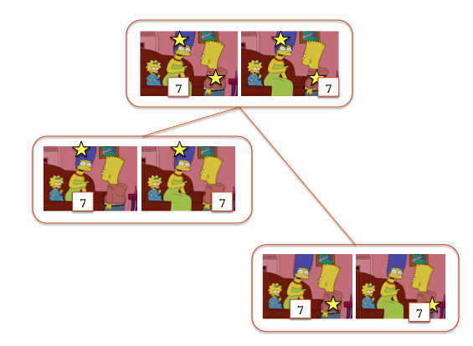
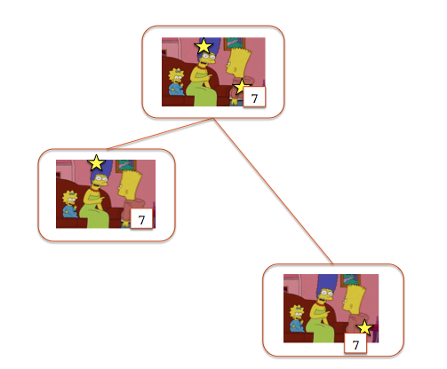
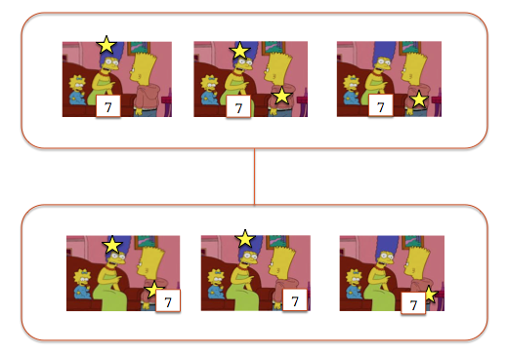
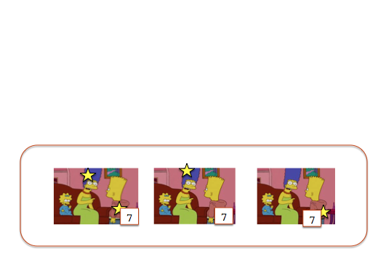
S[+7]S_{in}[DR]S_{dom}[ [[mere child]]^{υ} ]S_{res}[succeeded(7)]S'
S_{dom}:
S_{res}:

Slide 54
The υ mode of interpretation
LF: some(7)([[mere child]]^{υ})(succeeded)
[[F]]^{υ} = λD . { <S_{in},S_{out}> |
∃ S_{localQin} ∃ S_{localQout}
info(S_{localQin}) = info(S_{in}) ∧
S_{localQin} ⊆ {<I,I'> | ∃ G ∃ G' [ <G,G'> ∈ [[F]]^{A} ∧
I ⊆ info(↓G(D)) ∧ I' ⊆ info(↓G'(D)) ] ∧
S_{localQin}[ [[F]](D) ]S_{localQout} ∧
S_{out} = filter(S_{in}, info(S_{localQout})) }

Slide 55
S[+7]S_{in}[DR]S_{dom}[ [[mere child]]^{υ} ]S_{res}[succeeded(7)]S'
7
7
7
7
7
7
Notes:
This is the input state for nu

Slide 56
S[+7]S_{in}[DR]S_{dom}[ [[mere child]]^{υ} ]S_{res}[succeeded(7)]S'
7
7
7
7
7
7
Notes:
Then nu changes the question. We still have the same six world-assignment pairs, with two assignments per world, but now the information states are grouped according to the properties of the individual to which 7 is assigned. In the lower-ranked state, 7 is assigned to a child (Bart), and in the higher-ranked state, 7 is assigned to an adult (Marge). This satisfies the presupposition of “mere child”, which is that 7 is at least a child, thanks to the domain restriction that we performed earlier.

Slide 57
S[+7]S_{in}[DR]S_{dom}[ [[mere child]]^{υ} ]S_{res}[succeeded(7)]S'
7
7
7
Notes:
The at-issue content of “mere child” is that 7 is no more than a child, so the state in which 7 is assigned to an adult is eliminated.

Slide 58
S[+7]S_{in}[DR]S_{dom}[ [[mere child]]^{υ} ]S_{res}[succeeded(7)]S'
7
7
7
Notes:
After we are done processing the scope of the quantifier, the question is reset to “Who could defeat the Dark Lord”, with the world-assignment pairs that we have eliminated removed. They are all assignments mapping 7 to a child.

Slide 59
S[+7]S_{in}[DR]S_{dom}[ [[mere child]]^{υ} ]S_{res}[succeeded(7)]S'
7
7
Notes:
The restrictor says that 7 succeeded, so the state in which 7 was mapped Bart but Bart did not succeed is eliminated. This leaves us with two possibilities: Bart succeeded and nobody else did, or Bart and Marge succeeded.

Slide 60
Achieved:
The possibility of presupposing a question
The expressibility of presuppositional constraints regarding the strength ranking over the answers to the question under discussion
Quantificational binding into presupposed questions
Compositional derivation of logical forms for sentences

Slide 61
Appendix: [[mere child]]^{A}
[[child]]^{A} = {⟨[[baby]], [[baby]]⟩, ⟨[[baby]], [[child]]⟩, ⟨[[child]], [[child]]⟩, ⟨[[child]], [[adult]]⟩, ⟨[[adult]], [[adult]]⟩}
[[mere]]^{A} = {<λP.P, λP.P ⟩}
If [[αβ]] = f([[α]],[[β]]), then [[αβ]]^{A} ={⟨f(X,Y),f(X,Y')⟩|⟨X,X'⟩∈ [[α]] ∧ ⟨Y,Y'⟩∈ [[β]]^{A} (Krifka 1999)
So [[mere child]] ^{A} = [[child]]^{A}

Slide 62
References
Aloni, M., Beaver, D., Clark, B., and van Rooij, R. (2007). The dynamics of topics and focus. In Aloni, M., Butler, A., and Dekker, P., editors, Questions in Dynamic Semantics, CRiSPI. Elsevier, Oxford.
Beaver, D. (2001). Presupposition and Assertion in Dynamic Semantics. CSLI Publications, Stanford.Beaver, D. I. and Clark, B. Z. (2008). Sense and Sensitivity: How Focus Determines Meaning. Wiley-Blackwell, Chichester.
Coppock, E. and Beaver, D. (2011). Sole sisters. Paper presented at Semantics and Linguistic Theory (SALT 21).
Jäger, G. (1996). Only updates. In Dekker, P. and Stokhof, M., editors, Pro- ceedings of the Tenth Amsterdam Colloquium, Amsterdam. ILLC, University of Amsterdam.
Krifka, M. (1999). At least some determiners aren’t determiners. In Turner, K., editor, The Semantics/Pragmatics Interface from Different Points of View, pages 257–291. Elsevier, Oxford.

